Slide 1



Pathways for Quantum Infrastructure
Governing Quantum-HPC Convergence
- Quantum Effects 2025 -
Notes:
Good afternoon. I’m Sofie Schönborn from the Chair of Public Policy, Governance and Innovative Technologies at Technical University of Munich, and part of TUM's Quantum Social Lab.
Today I am presenting this work-in-progress on how quantum and HPC are converging, and what that means for governing infrastructure pathways — with an eye on resilience, digital sovereignty, and innovation policy.
We are identifying two integration pathways, across four exploratory EU/US cases, and briefly discuss governance takeaways.
Let me start with why this matters now.

Slide 2


KEY POLICY PROGRAMS FRAME COMPUTE AS STRATEGIC CAPACITY
EuroHPC positions HPC/AI/quantum capacity as strategic assets (e.g., Quantum Europe Strategy), making architectural choices, on-prem vs. cloud-mediated, decisions about resilience, auditability, and public value.
The situation
  Quantum and HPC are converging from pilots to infrastructure choices (architectures, interfaces, schedulers, procurement).
  Early decisions create path dependencies (toolchains, vendor ecosystems, skills) that will be expensive to undo.
  Current debate emphasizes hardware counts and vendor announcements; it under-specifies integration and governance.
The stakes
  Scientific performance: latency, throughput, and reproducibility for real workloads.
  Access & capability building: who can program, optimize, and measure.
  Sovereignty & public value: where accountability sits (labs vs platforms), data handling, standards leadership.
Notes:
Quantum–HPC integration is moving from pilots to practical integration decisions: about architectures, interfaces, and schedulers. [More and more HPC centres are announcing access or partnerships with Quantum solutions...]
However, we know: Early choices can create path dependencies — toolchains, vendor ecosystems, skills — that are expensive to unwind.
The usual public debate often tracks qubit counts and vendor news [new quantum computer for JUNIQ, Scientists at Caltech just synchronized 6,100 qubits]; what’s easily falls short in those breaking news is integration and governance.
The stakes? Not only scientific and industrial throughput (latency, queues, reproducibility), capability building, access, (who gets to program and optimize), and public value shaping and sovereignty.
Today we’ll explore the framing of Q-HPC integration as infrastructural pathways so we can compare and steer these choices better.
But first, we zoom out just a second.
We see that compute capacity is being treated as a strategic capacity by policymakers across the world.
Key public programs — e.g., EuroHPC — explicitly frame HPC/quantum capacity as strategic assets.
That turns architectural choices — like on-prem vs cloud-mediated — into decisions not only about technical and financial outcomes, but also societal ones (resilience, public interest, sovereignty).

Slide 3
OUR DESIGN
  Treat Q-HPC as infrastructural pathways (revisitable trajectories) and analyze design-as-governance (interfaces, schedulers, maintenance, procurement).
  Compare EU/US cases to identify lock-ins, signposts, and actionable levers.
Guiding questions
  Which integration pathways are stabilizing where?
  How do design choices allocate capability, access, and accountability?
Notes:
That means: Infrastructure is policy by other means. Our move in this project is to analyze this design-as-governance — choices in the Quantum-HPC integration pathway — and compare EU/US cases from large research centers to surface governance implications.
To achieve this, we apply the theoretical lens of infrastructure studies to Q-HPC. We focus on infrastructural pathways to analyse first exemplary cases - today from the EU and US - to better understand governance implications of these trajectories.
Our guiding questions for this first exploratory part of our research are:
Which integration pathways are stabilizing where -- and why?
How do design choices allocate capability, access, and accountability?

Slide 4
Q-HPC CONVERGENCE
Quantum Computers are in their nascent stage; however, three different architectural subcategories are crystallizing
(Saurabh et al. 2023):
  Quantum-in-HPC: Within Hybrid Architectures, Quantum Computing Units (QPU) are treated as additional accelerators, utilized for certain computing tasks; HPC is coming after the measurement cycles
    Workload Specialization: Molecular simulation, cryptography, and optimization inside workflows.
    Cloud + HPC Convergence: Cloud services piloting this accelerator model already.
    Short-Term Pathway: Closest to commercialization — companies already experimenting with hybrid quantum-classical APIs.
  Quantum-about-HPC: Quantum used as a black box, main control loops remain the HPC systems
    Algorithmic Abstraction Trend: Similar to how linear algebra libraries hide GPU internals — researchers don’t code gates, they call quantum solvers.
    Simulation Trend: Quantum-as-a-service for physical/chemical simulation; HPC orchestrated workflows.
    Trust in Abstraction: Moves towards usability — quantum tech hidden behind APIs, reducing barrier to adoption.
    Mid-Term Adoption: Fits the “black-box solver” model enterprises are used to with HPC toolchains.
  HPC for Quantum (Hybrid Architectures): Quantum and HPC Systems are connected as two parallel systems
    Current limiting factor: Quantum System Part; Future limiting factor: Classical System Part ⟶ Predictable change of infrastructural bottlenecks!
    Co-design Trend: Pushes hardware–software co-optimization, a trend seen in AI accelerators as well.
Notes:
We use a pragmatic typology, proposed in another paper by Saurabh et al. (2023).
First, Quantum-in-HPC: QPUs as accelerators inside hybrid workflows; clouds are already piloting this.
Second, Quantum-about-HPC: quantum as a black-box solver; HPC orchestrates.
Third, HPC-for-Quantum: HPC as the heavy lifter for quantum R&D and co-design.
For today’s analysis we focus on the first two because they show clearer integration and governance artifacts now; we park HfQ for a follow-on paper explicitly about co-design and simulation.

Slide 5
THINKING INFRASTRUCTURALLY
Infrastructure = ensemble of material systems, standards, interfaces, routines, and institutions that enable other activities to function, becoming taken-for-granted through use while organizing access, coordination, and control. (c.f. Star & Ruhleder, 1996; Larkin, 2013)
Four complementary lenses
  Infrastructuring (practice-oriented): Infrastructure is never finished; it’s built/maintained through mundane work—classifications, interfaces, scheduling, calibration, documentation. (Star & Ruhleder, 1996; Pipek & Wulf, 2009)
  Politicality: Infrastructures shape subjects and spaces; their politics becomes most visible in breakdowns and absences. (Larkin, 2013)
  Platformization: Private platforms increasingly become infrastructure, relocating accountability and public value provision. (Plantin, Lagoze, Edwards, & Sandvig, 2018)
  Sociotechnical imaginaries: National/organizational visions align investment and institutional design (e.g., “exascale + quantum,” “sovereignty”). (Jasanoff & Kim, 2013)
Applied to Q-HPC
  Key infrastructural elements: IRs/compilers (e.g., QIR), APIs/SDKs, scheduler policies, telemetry/observability, facility ops (cryo, calibration).
  Design choices in these elements are governance choices (who can do what, when, and under which pivotal conditions).
Notes:
Now, looking at our theoretical angle, I will briefly introduce you to infrastructure studies / infrastructural thinking.
In infrastructure studies, infrastructure isn’t just a hardware you buy; it’s the ensemble of material systems, standards, interfaces, routines, and institutions that other work depends on and usually takes for granted.
Some quick perspectives from this field of research, I want to highlight:
Infrastructuring (practice over product).
Infrastructure is made and remade in use—through scheduling rules, documentation, provisioning, calibration, and repair. The focus is not only design-time, but the everyday work that keeps systems usable and coordinates heterogeneous actors.
Breakdowns reveal infrastructures.
We see the politics of infrastructure most clearly where things fail or access is withheld: who controls or restricts access, who can prioritize jobs or users, and who is authorized or able to repair.
Platformization (who is the infrastructure?).
Historically, many infrastructures were publicly owned or governed (utilities, transport). In recent times, private increasingly become infrastructure - in more classical sectors through PPPs, and in the digital sector also as primary actors. This shifts accountability, auditability, and value creation from public authorities to vendors. But this also alters where standards are set, where transparency lives, and who bears certain risks.
Installed base and path dependence.
Infrastructures grow by layering on an installed base; interfaces must “fit” what already exists. [example from quantum - able to speak to APIs, use IP protocols, but also work within established law and institutions, etc.]
Early design choices create lock-ins and switching costs that shape future possibilities.
(--> For example railways: railways. The now-dominant standard gauge (1435 mm) spread early through investment, rolling stock, depots, bridges, maintenance, and regulation. Regions that adopted different gauges (e.g., Iberian 1668 mm) face persistent interoperability friction: break-of-gauge stations, variable-gauge bogies, special logistics. Even when new high-speed lines standardize, the legacy network—and everything built around it—anchors choices for decades. That’s path dependence driven by the installed base and complementary assets.)
Maintenance as capacity.
Just designing an infrastructure does not immediately bring reliability or availability. It comes from sustained maintenance, monitoring, and continued development. Resilience of infrastructure depends on these capabilities as well.
Finally, and I see we are seeing this quite well in the quantum-context, infrastructures are justified by collective visions—efficiency, sovereignty, “scientific leadership.” These imaginaries align investments and set the criteria by which infrastructures are judged viable or legitimate.

Slide 6
INFRASTRUCTURAL PATHWAYS
Infrastructural pathways are patterned, revisitable sequences of design and governance choices through which infrastructures evolve, stabilize, or switch under conditions of uncertainty, path dependence, and lock-in.
Why this contributes to thinking about quantum governance
  Moves debate beyond hardware counts to design–governance mechanisms (APIs/IRs, schedulers, procurement, maintenance).
  Identifies lock-ins (toolchains, vendor ecosystems) and switching costs early, before they harden.
  Clarifies sovereignty levers: data locality clauses, standards participation, on-prem integration requirements, incident reporting.
Two Q-HPC pathways
  Decentrally coupled (cloud-mediated) → emphasizes interoperability, elasticity, platform governance; risks: dependency on proprietary APIs/queues.
  Tightly integrated accelerators (co-located/in-node) → emphasizes low-latency control, scheduler co-design, facility ops; risks: higher site complexity, specialized skills.
Notes:
Infrastructural pathways are the patterned, revisitable sequences of design-and-governance choices through which an infrastructure evolves and stabilizes over time (scholars have traced the evolution of different infrastructures from mobility- to internet-related infrastructures).
Why this lens helps:
It names the control points (interfaces, standards, schedulers, telemetry) that determine access, oversight, and accountability.
It makes lock-ins and switching costs visible early, before they harden.
It reframes “technical choices” as governance choices, clarifying where public value and resilience actually live.
At later stages, it can offer actionable levers: standardization requirements, transparency/observability obligations, and procurement clauses tied to maintainability and portability.
-->
With this lens, we can now contrast the two integration pathways we observe.

Slide 7
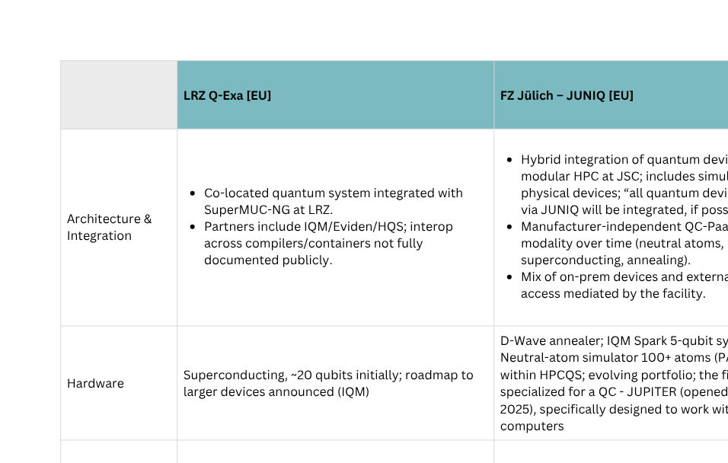
EXPLORATORY INTERNATIONAL CASES
Notes:
We compare EU and US exemplars [for comparability selecting large-scale research facilities].
We look at: (i) Architecture and Integration, how tightly or abstractly are the quantum systems integrated and with which vendors; (ii) what hardware is running with which specs; (iii) what is known about the middle ware (compilers/ IRs/ runtimes); (iv) and then the governance and access regimes.
The cases cover two EuroHPC centers: (1) LRZ in Munich with its Q-Exa, Germanys first hybrid quantum computer; (2) the JUNIQ, a manufacturer-independent public quantum computing user facility at Jülich Supercomputing Centre; and two US facilities: (1) the Oak Ridge Leadership Computing Facility, which provides access to quantum computing resources via its Quantum Computing User Program (US Department of Energy's); and (2) the US National Energy Research Scientific Computing Center (NERSC) at Berkeley Lab, with their Quantum Computing Access (QCAN) program.
We coded publicly available data on these on architecture, hardware, and basically software abstraction, and governance/access.
> The punchline: EU sites (so far) emphasize facility-led integration and scheduler co-design; US sites emphasize platform-mediated breadth and user growth.
While I have to say, from left to right, LRZ is heavier focused on investments in QPUs, while Jülich seems to emphasize the platform focus more. Also, QCUP just announced a first co-location, as IQM Radiance quantum computer will be added on-prem.

Slide 8
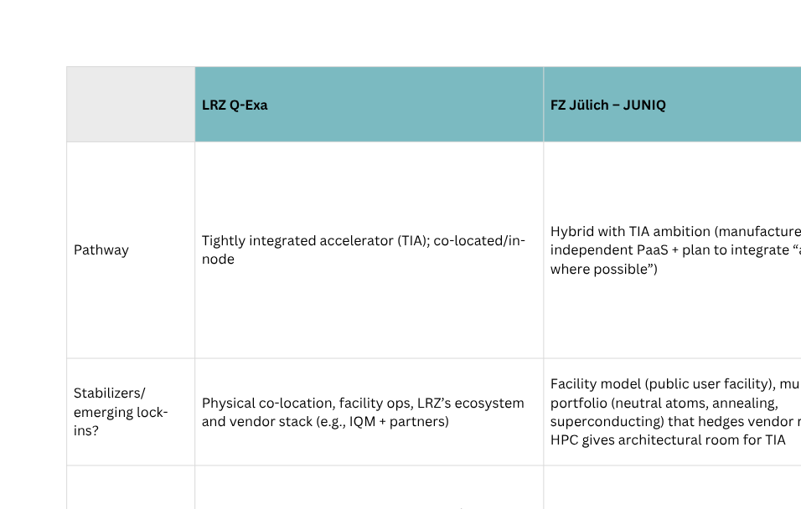
Infrastructural pathways -patterned, revisitable sequences of architectural & governance choices
EXPLORATORY INTERNATIONAL CASES
Notes:
Decentrally coupled (cloud-mediated)
HPC workflows with remote QPUs via cloud/ gateway APIs.
Pros: Fast to scale, multi-vendor access, minimal on-site operational burden.
Trade-offs: Higher end-to-end latency; APIs/queues/telemetry governed off-site (platform dependence); potential lock-ins.
Tightly integrated accelerator (co-located / in-node)
On-prem QPUs physically tied to supercomputing environment.
Pros: Lower latency, deeper scheduler co-design, greater on-site control over interfaces and observability.
Trade-offs: Higher facility complexity; sustained calibration/maintenance capacity required.

Slide 9
TWO PATHWAYS FOR Q-HPC INTEGRATION
Decentrally coupled (cloud-mediated)
HPC workflows with remote QPUs via cloud/ gateway APIs.
Pros: Fast to scale, multi-vendor access, minimal on-site operational burden.
Trade-offs: Higher end-to-end latency; APIs/queues/telemetry governed off-site (platform dependence); potential lock-ins.
Tightly integrated accelerator (co-located / in-node)
On-prem QPUs physically tied to supercomputing environment.
Pros: Lower latency, deeper scheduler co-design, greater on-site control over interfaces and observability.
Trade-offs: Higher facility complexity; sustained calibration/maintenance capacity required.
Notes:
The two pathways, as discussed.
You may ask: isn’t cloud the only viable path today?
- I would argue, yes, a lot of learning happens via cloud breadth. But for regulated or latency-sensitive workloads, on-prem integration will preserve control over interfaces, telemetry, and incident response — that’s a sovereignty and resilience issue, not just performance.
And of course, the two pathways are not mutually exclusive. Treat them as a portfolio: scale cloud-coupled breadth while maturing targeted on-prem accelerators where it matters.

Slide 10
WHAT THIS TELLS US ABOUT INFRASTRUCTURING GOVERNANCE
Design choices = governance levers
    APIs/IRs decide portability and who can optimize at which layer.
    Schedulers/queues allocate priority and observability.
    Facility ops (calibration/drift management) determine effective access (EDT).
    DC pathways concentrate these levers in platforms; TIA pathways keep more levers on-site.
Lock-ins are already forming, but still revisitable
    Toolchain habits (Qiskit/CUDA-Q), contract terms, and user onboarding create soft lock-ins.
    Early scheduler primitives and IR convergence can reduce switching costs later.
Notes:
Implications we identify:
Design choices are indeed governance.
> Interfaces/IRs decide portability and who can optimize; schedulers/queues allocate priority and observability; facility ops determine effective access. In decentral pathways, these levers sit with platforms; in tight integration, more remain on-site.
Platformization creates soft lock-ins
> Decentralized models centralize APIs, pricing, incident handling in private providers/ platforms; metrics and access norms can harden off-site.
Resilience & sovereignty are already relevent when making architectural choices
> Where control points sit — APIs, telemetry, incident response, data locality — determines auditability, recovery, and resilience.

Slide 11
OUTLOOK
Q-HPC is currently a portfolio of pathways, not a race to one architecture
  LRZ and (parts of) JUNIQ show tightly integrated accelerators (TIA) can work where facility ops + scheduler co-design exist.
  NERSC and QCUP show decentral cloud coupling (DC) scales access fast, but outsources key levers (APIs, queues, observability).
    Governance perspective: treat DC and TIA as complements with different value propositions.
Comparative value EU ↔ US
  EU strength: facility-led TIA pilots (LRZ, JUNIQ via EURO-Q-Exa) → sovereignty + deeper scheduler co-design.
  US strength: breadth/throughput via DC (QCUP, NERSC) → rapid experimentation and user growth
Notes:
Q-HPC is currently a portfolio of pathways, not a race to one architecture.
LRZ and (parts of) JUNIQ show tightly integrated accelerators (TIA) can work where facility ops + scheduler co-design exist.
--> tightness already in itself is a governance decision (or may have arisen from an existing path dependency) (hidden correlation?)
NERSC and QCUP show decentral cloud coupling (DC) scales access fast, but outsources key levers (APIs, queues, observability).
Governance perspective: treat DC and TIA as complements with different value propositions.
Comparative value EU ↔ US
EU strength: facility-led TIA pilots (LRZ, JUNIQ via EURO-Q-Exa) → sovereignty + deeper scheduler co-design.
US strength: breadth/throughput via DC (QCUP, NERSC) → rapid experimentation and user growth

Slide 12
REFERENCES
Geels, F. W. (2016). The enactment of socio-technical transition pathways. Research Policy, 45(4), 896–913.
Geels, F. W., & Schot, J. (2007). Typology of sociotechnical transition pathways. Research Policy, 36(3), 399–417.
Haasnoot, M., Kwakkel, J. H., Walker, W. E., & ter Maat, J. (2013). Dynamic adaptive policy pathways. Global Environmental Change, 23(2), 485–498.
Humble, T. S., McCaskey, A., Lyakh, D. I., Gowrishankar, M., Frisch, A., & Monz, T. (2021). Quantum computers for high-performance computing. IEEE Micro, 41(5), 15-23.
Jasanoff, S., & Kim, S.-H. (2013). Sociotechnical imaginaries and national energy policies. Science as Culture, 22(2), 189–196.
Larkin, B. (2013). The politics and poetics of infrastructure. Annual Review of Anthropology, 42, 327–343.
Pipek, V., & Wulf, V. (2009). Infrastructuring. Journal of the Association for Information Systems, 10(5), 306–332.
Plantin, J.-C., Lagoze, C., Edwards, P. N., & Sandvig, C. (2018). Infrastructure meets platform studies. New Media & Society, 20(1), 293–310.
Saurabh, N., Jha, S., & Luckow, A. (2023, July). A conceptual architecture for a quantum-hpc middleware. In 2023 IEEE International Conference on Quantum Software (QSW) (pp. 116-127). IEEE.
Shehata, A., Groszkowski, P., Naughton, T., Meena, M. G., Wong, E., Claudino, D., ... & Beck, T. (2026). Bridging paradigms: Designing for HPC-Quantum convergence. Future Generation Computer Systems, 174, 107980.
Star, S. L., & Ruhleder, K. (1996). Steps toward an ecology of infrastructure. Information Systems Research, 7(1), 111–134.

Slide 13
CASE REFERENCES
https://www.lrz.de/en/news/detail/germany-launches-its-first-hybrid-quantum-computer-at-leibniz-supercomputing-centre
https://www.gauss-centre.eu/news/leibniz-supercomputing-centre-integrates-classical-and-quantum-computing-with-q-exa
https://www.lrz.de/en/news/detail/ion-trap-quantum-computer-ready-for-novel-research-and-development-at-the-lrz
https://www.eurohpc-ju.europa.eu/boosting-europes-quantum-computing-infrastructure-2024-12-02_en
https://www.fz-juelich.de/en/ias/jsc/systems/quantum-computing/juniq-facility/juniq
https://juniq.fz-juelich.de/hub/login?next=%2Fhub%2Fhome
https://www.olcf.ornl.gov/olcf-resources/compute-systems/quantum-computing-user-program/
https://docs.olcf.ornl.gov/quantum/quantum_access.html
https://www.nersc.gov/what-we-do/computing-for-science/quantum-information-science
https://www.nersc.gov/users/user-news/apply-for-quantum-computing-access-via-qcan-program-2

Slide 14


Contact
Sofie Schönborn & Fabienne Marco
Quantum Social Lab
Richard-Wagner-Straße 1
80333 München
Sofie.Schoenborn@tum.de
Fabienne.Marco@tum.de

